Slide 1
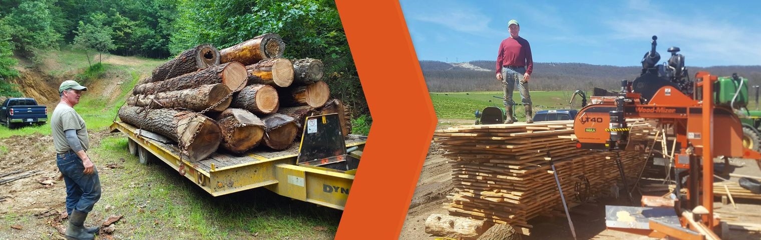

From tree to boards
Wait wood is how expensive?

Slide 2
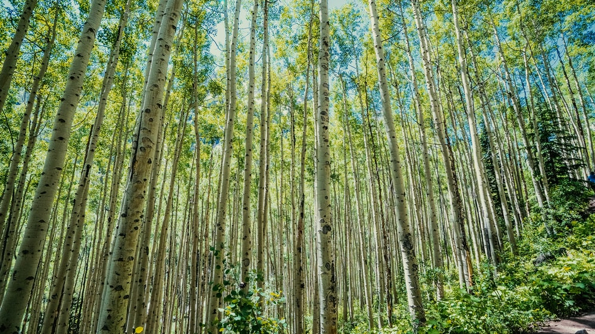
Find a forest
Get permission to harvest
You do not want the pointy end of “tree law”
Fun fact: “Jackson Oak” in Atlanta, GA
Bonus, inheritance!
Best time is winter

Slide 3
Find a tree
Not close to structures
Not rotted
Windowmakers
Standing dead trees OK
Leave some for wildlife!
No twisted bark/grain
No lopsided limbs
Unpredictable fall
Species of tree
Notes:
If you are looking for firewood then fallen trees are best for this—just be sure to check for wood eating insects.

Slide 4
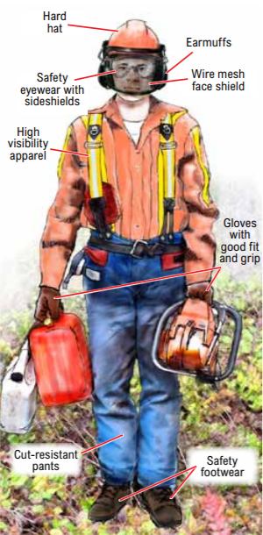
Personal Protection Equipment
Safety pants!
Steel toed boots
Gloves (vibration!)
Eye protection
Ear protection
Hard hat
Hammer + wedges

Slide 5
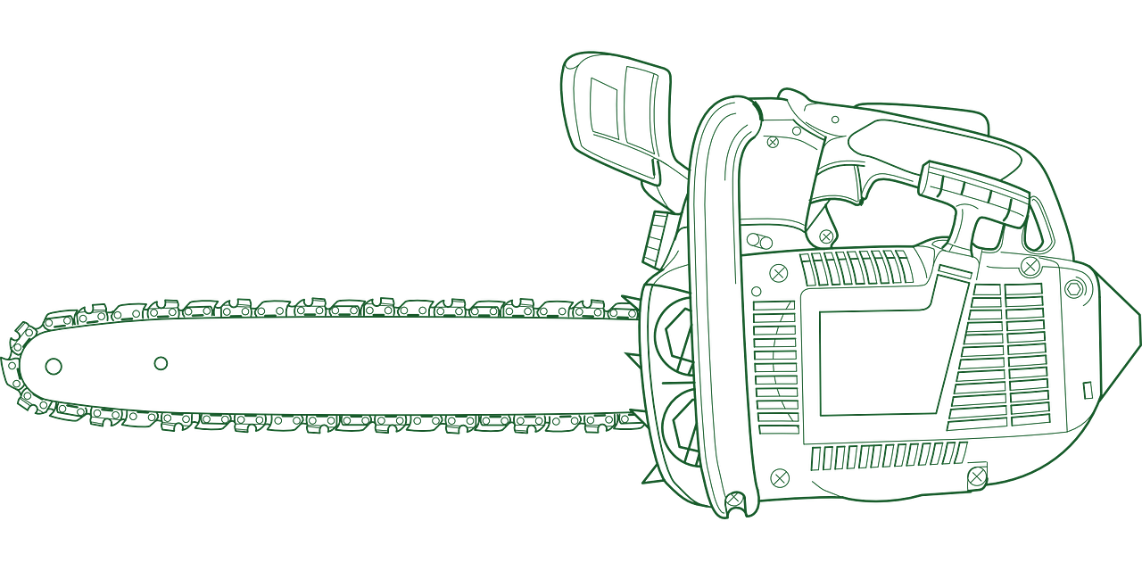
Choosing a chainsaw
Bar length
Gas vs electric
Notes:
Fast and dangerous

Slide 6
Using a chainsaw
Route of egress
Falling los can kickback
Fallen logs can roll
Spotter (safety)
Stance
Stand to the side
Firm grip
Starting
Cut with base of bar
Avoid dirt
Bar getting pinched

Slide 7
Maintaining a chainsaw
Fuel mix
Sharpening
Cross vs Straight cut
Chain tension
Safety chain brake
Notes:
2 stroke
Sharpening can be done yourself or at a rural hardware store
Tension: pulling chain away from middle of bar should JUST barely come out of the groove then snap back.

Slide 8
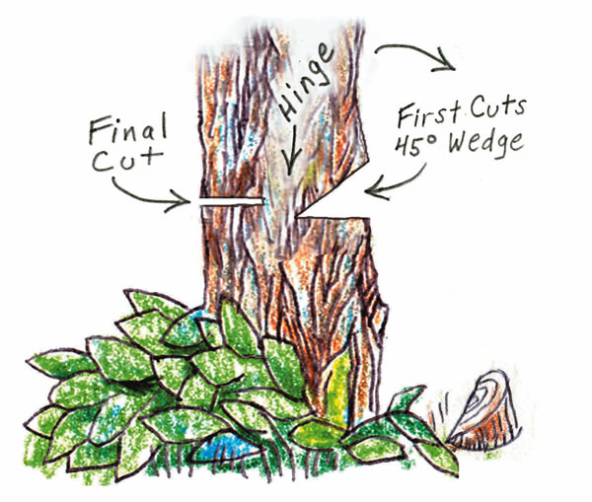
Felling
Clear obstacles around tree
Pick a direction for tree to fall
Beware lopsided limbs
Escape route
How to cut hinge

Slide 9
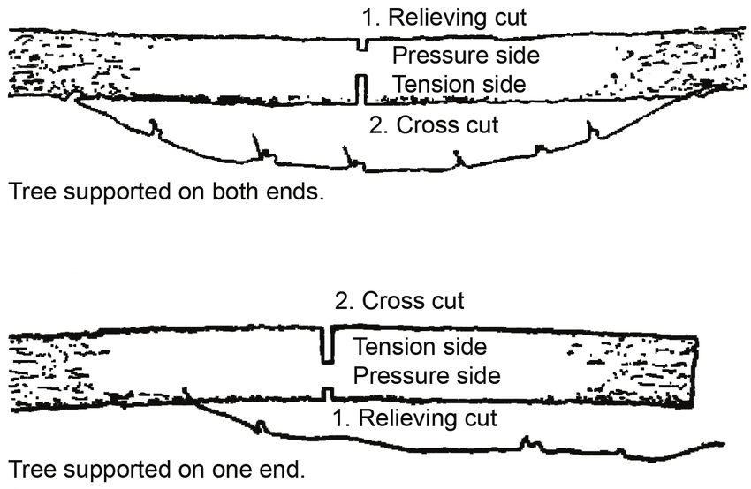
Bucking
De-limb first
Tree can roll
Sectioning into smaller pieces
Tree can roll
Transporting sections

Slide 10
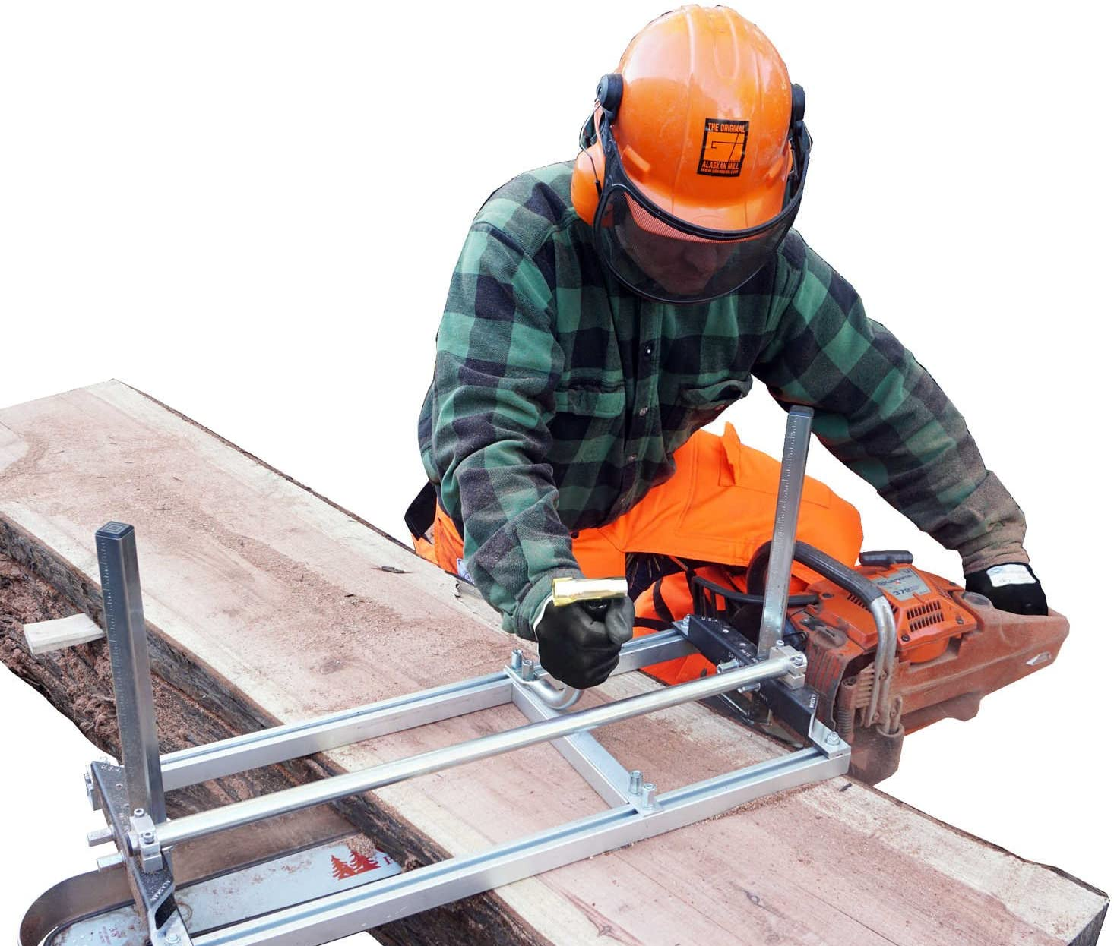
“Alaskan” chainsaw mill
Attaches to your chainsaw
Extremely portable
Easier to transport boards than a log
Height adjustable
leave room for drying
Needs a “starter board”
Large wasteful kerf

Slide 11
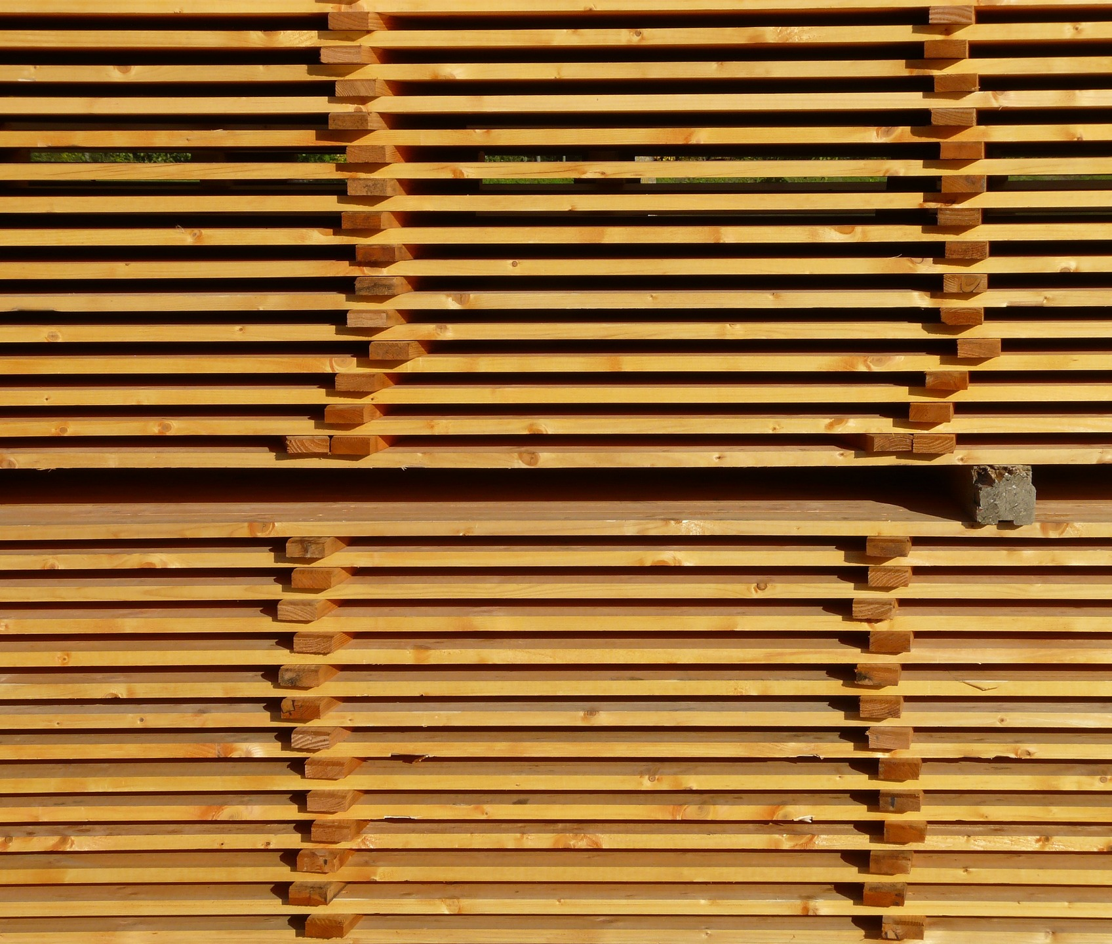
Drying
Stack with 1 inch wooden spacers
Shims cause warping
18 in apart
Covered top, open sides
Place in windy spot
1 year per inch thickness, roughly
Shrinkage will happen
Rough lumber

Slide 12
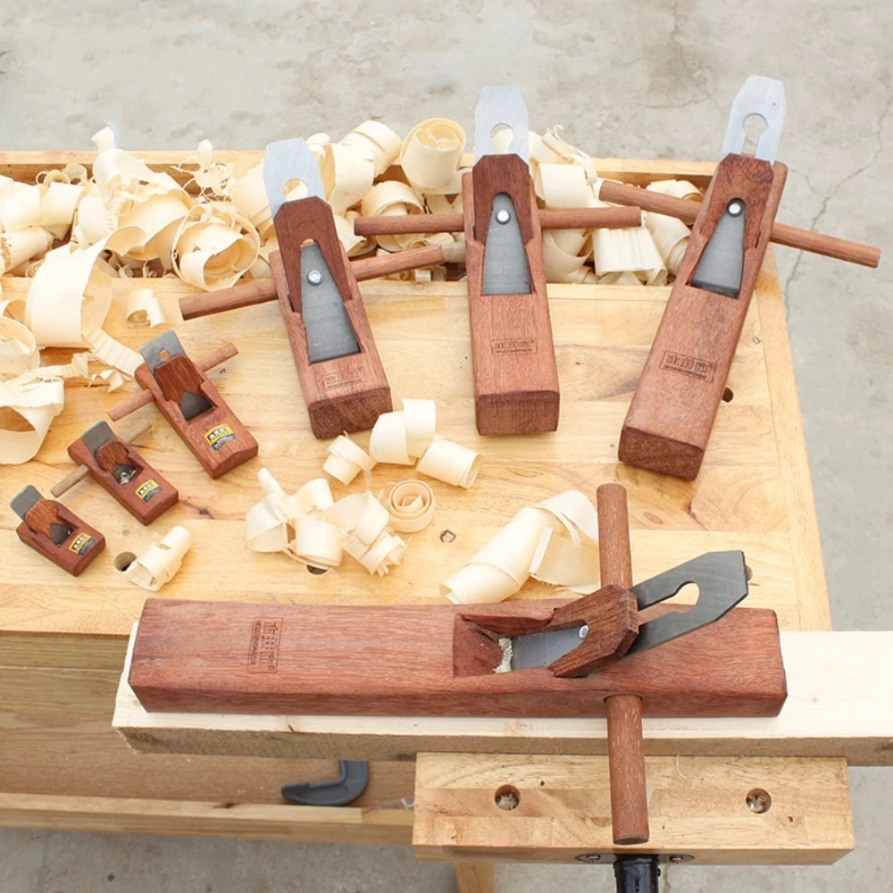
Planing wood
Wood planer
Hand planer
Tablesaw Jig
Dimensional lumber

Slide 13
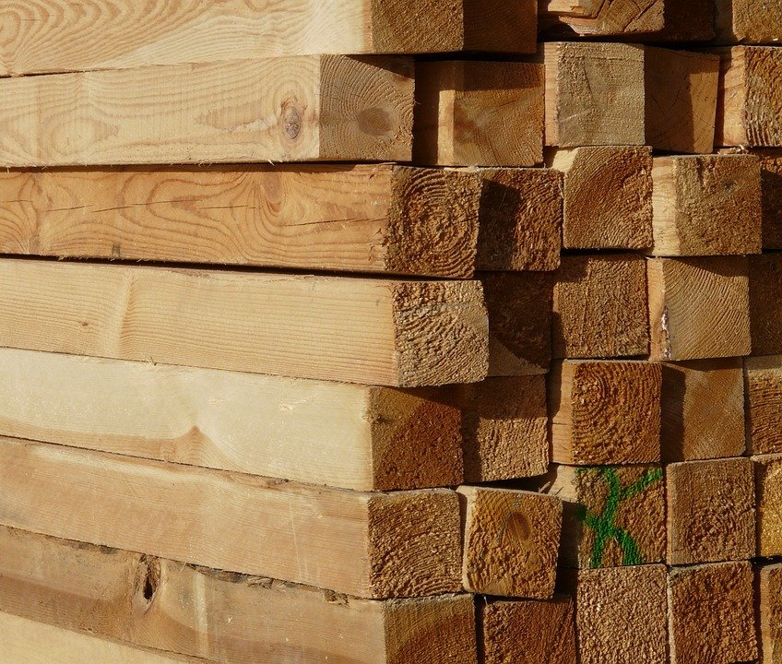
References
Grandpa
“A Reverence for Wood” by Eric Sloane
Mr. Chickadee’s YouTube channel
YouTube in general
Notes:
Grandpa can even be your spotter, or if you know neighbors (or me) you can take turns on the saw.

Slide 14
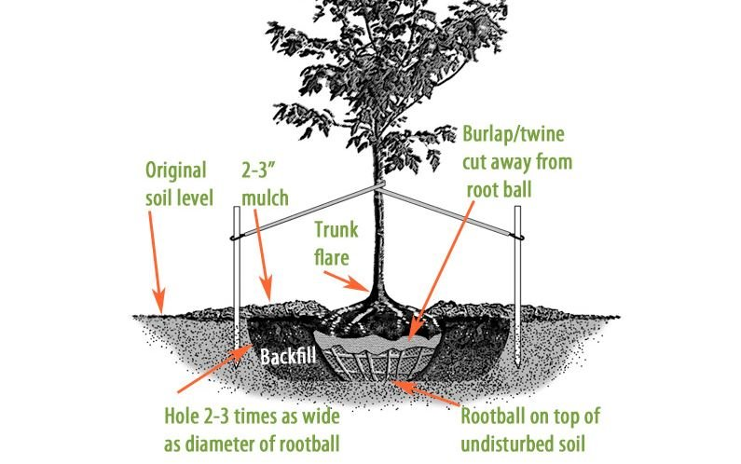
Take a tree, leave a tree
If doing large scale lumbering then replant!

Slide 15

Q&A / Fin

Slide 16
Choosing a tool
Personal Protection Equipment
Chainsaw
Axe
Manual saw

Slide 17
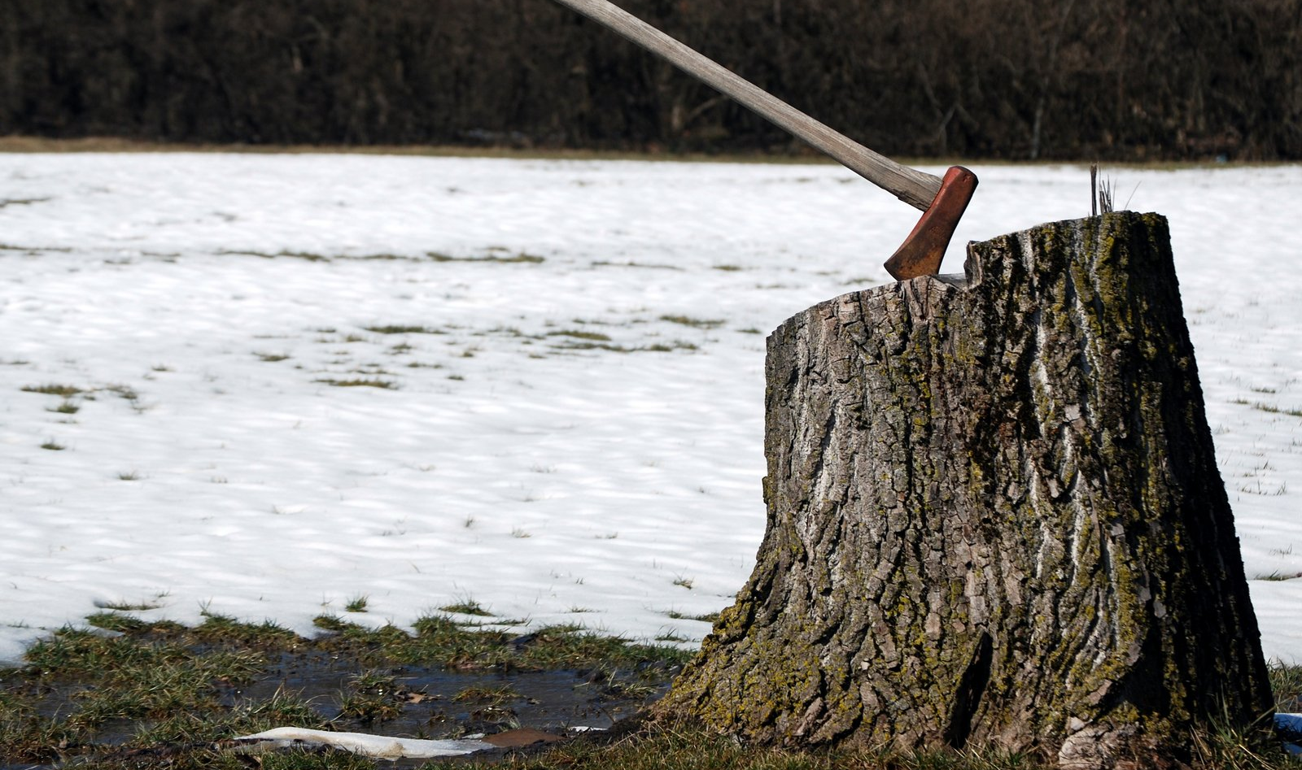
Choosing an axe
More than one type of axe
Broad
Adz
Maul
Felling
Boy’s
Fiberglass vs wood handle
Handle length
Head material quality
Sharpening
Notes:
Slow and dangerous
Work off the isolation weight

Slide 18
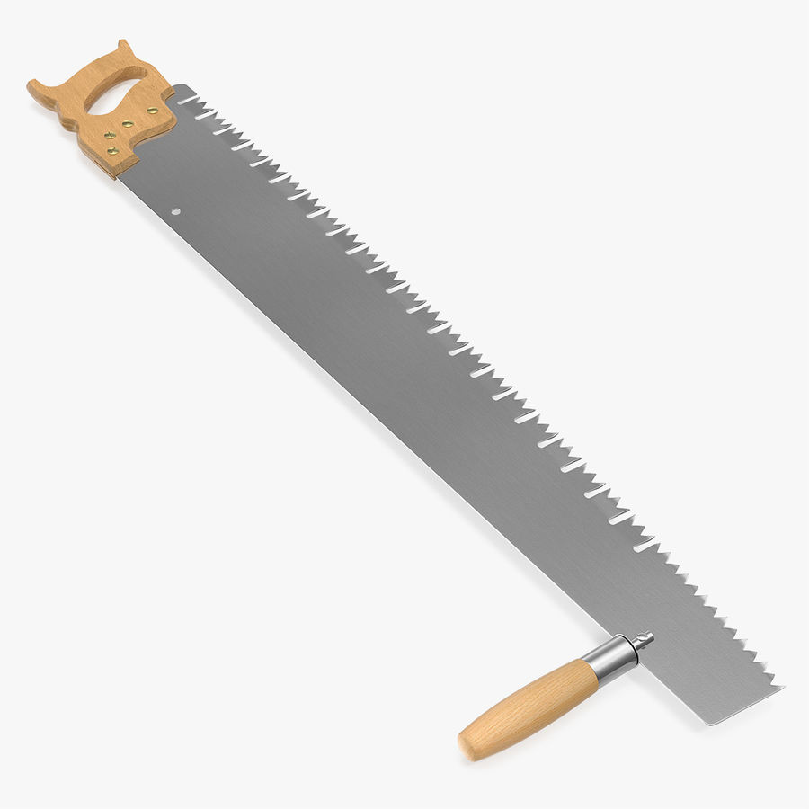
Manual saw
Boring
One or two or variable person saws
Cross cut vs straight cut
Sharpening
Notes:
Slow and safe

Slide 19
Hewing
Log dog

